Slide 1
ONE PERSON IN GROUP-> CLICK USE TEMPLATE
WHEN THE COPIED TEMPLATE OF THESE SLIDES OPENS IN A NEW TAB:
ADD YOUR Group NAME TO THE TITLE
SHARE WITH GROUP MEMBERS (USE SHARE BUTTON)
COPY THE TITLE AND LINK TO YOUR RECORDS (Digital folder/table of contents)
Remember it is advisable to make a PERSONAL copy and link it when DONE

Slide 2
Dilutions

Slide 3
ESSENTIAL QUESTIONS
Remember, you should be able to thoroughly answer these AFTER learning through following resources.
How can we calculate dilutions and concentrations we need in the lab?
How can we safely prepare dilutions for our needs?

Slide 4
Instructions
Follow through the Engage to Apply resources in order .
Once complete, choose from Extend resources as interested.
Record your learning in your these slides- Remember to keep track of where to find these slides for studying!
Complete the Essential Questions Response in the Apply Section.
Try the Extend section and optional Apply practice as desired to deepen your understanding

Slide 5
Hyperdoc Elements
Click for quick access to:
Engage
Explore
Explain
Apply
Extend

Slide 6
Terminology - As you encounter terms new to you, define in your own words here, include examples (make them up!)

Slide 7
Part 1: ENGAGE

Slide 8
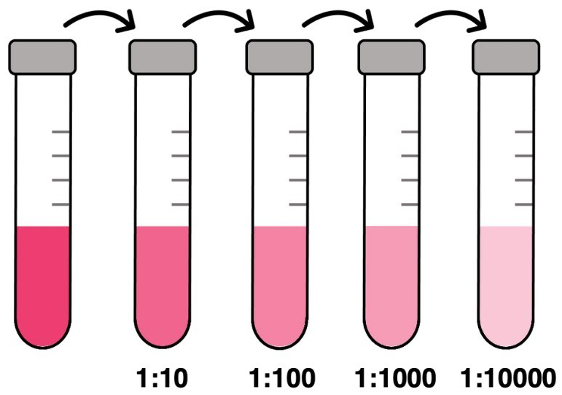
Explore - Part A: 5 minutes
Make two observations & one inference about the image on the right:
Observations:
Inference:
Notes:
https://www.scientificamerican.com/article/fact-or-fiction-archimede/

Slide 9
Part 2: EXPLORE

Slide 10
Explore - Preparing Solutions
Preparing solutions with known concentrations is an important skill in chemistry
➢Prepared Solutions with known concentrations - Standard Solution
➢Purchased Solutions from a Chemical Provider - Stock Solution
○Both used for accurate stoichiometric calculations
There are two ways to prepare Standard Solutions:
1.Dissolving solid solutes in a Volume of water
2.Diluting a Stock Solution to a required Concentration

Slide 11

Explore - Glassware & Tools
Because solutions need to be accurate and reliable, there are special pieces of glassware we can use to prepare solutions:
Volumetric Flask: a flask that measures a single volume with very high accuracy
Graduated Cylinder: a piece of glassware with gradations, that can measure many volumes
Pipette: a piece of glassware with gradations that can measure volumes with high accuracy

Slide 12
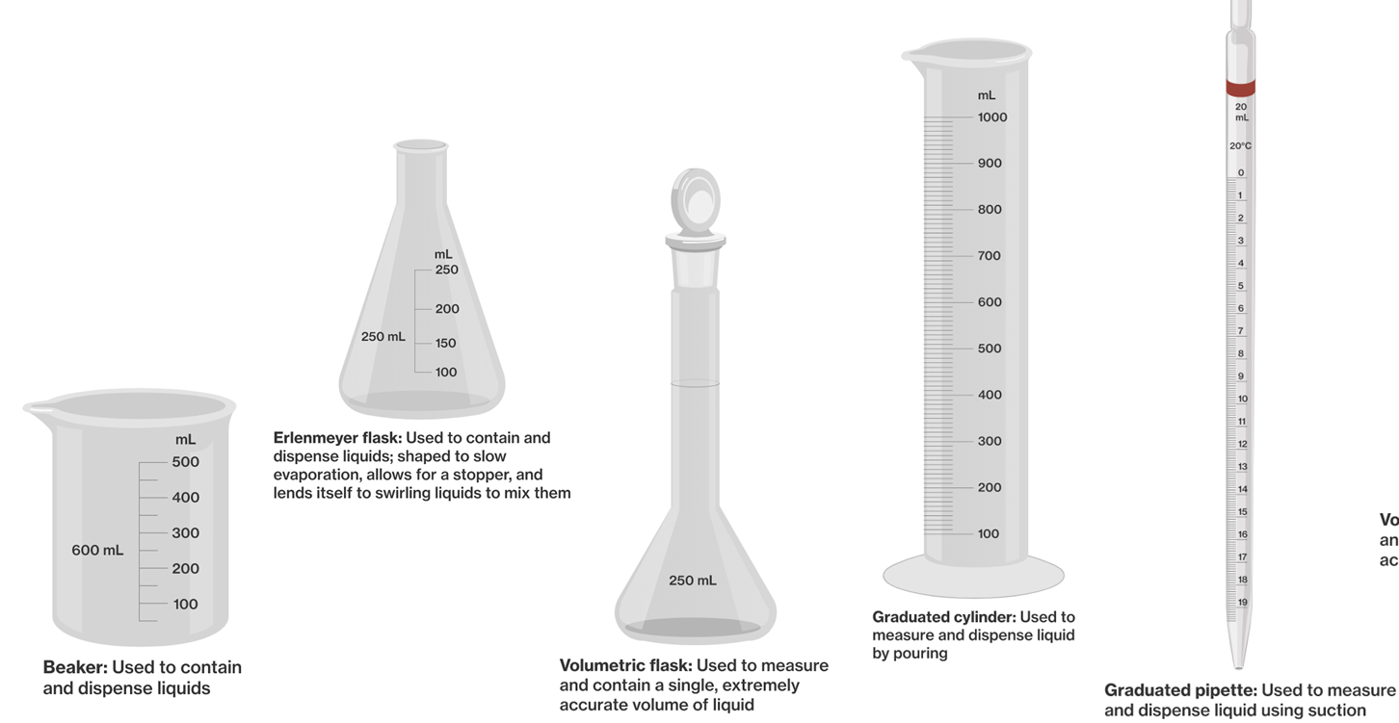
Explore - Glassware & Tools

Slide 13
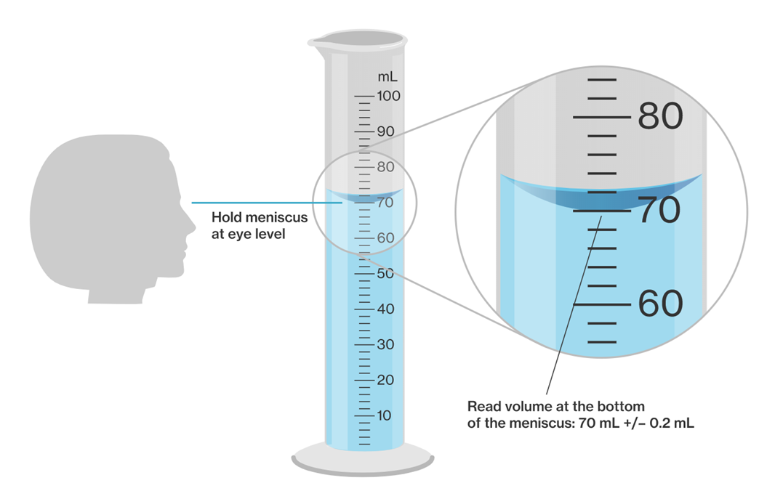
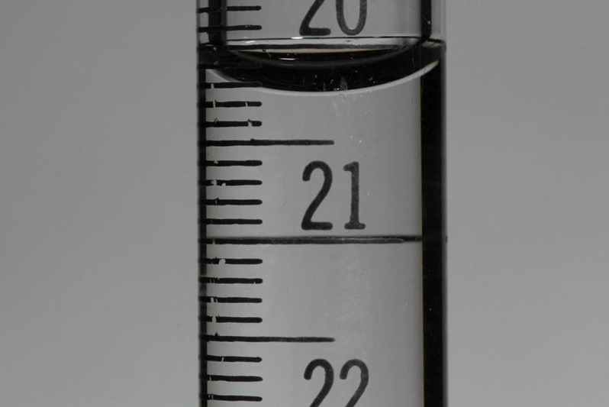
Explore - Measuring Volumes
When measuring volumes of liquids, it is important to consider the meniscus
When measuring liquids, you must measure from the BOTTOM of the meniscus

Slide 14
Explore - Preparing Solutions
Solutions with Solid Solutes can be prepared using the following steps:
Measure mass of solute using balance
Dissolve solute in water (less than total volume)
Pour mixture to volumetric flask
Rinse beaker with distilled water, and pour mixture into volumetric flask. Repeat this step twice.
Add solvent to correct volume.
Mix and store solution in container.

Slide 15
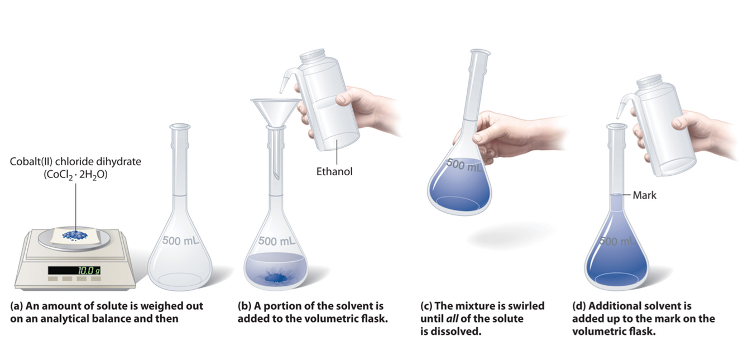
Explore - Preparing Solutions

Slide 16
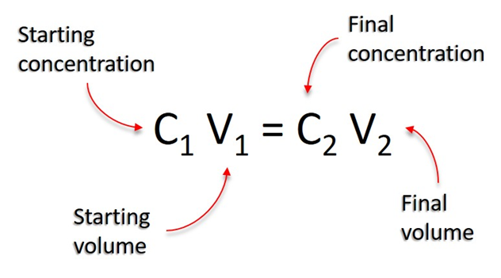
Explore - Solutions from Dilutions
Highly concentrated solutions from a manufacturer are called stock solutions
➢Concentrations often too high for experiments
➢diluted to useful concentrations by adding more solvent
The solution-dilution equation can help us determine how to dilute to get desired concentrations

Slide 17
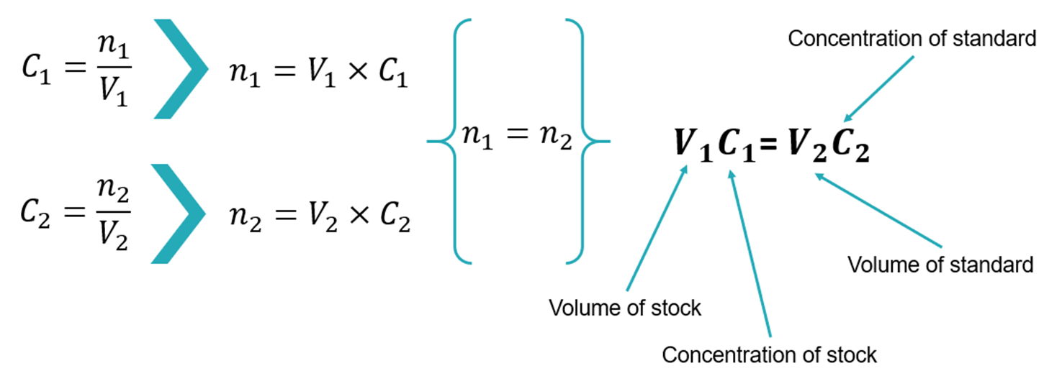
Explore - Solution-Dilution Equation
Discuss! Why does n₁ = n₂? Remember you are DILUTING a volume (v₁) of the stock to a new higher volume but lower concentration solution.

Slide 18
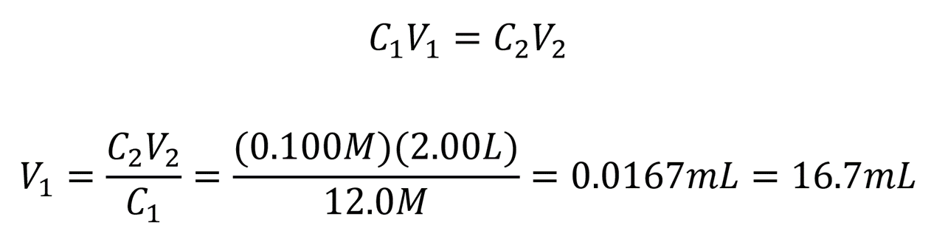
Explore - Solution-Dilution Practice
Ms.K & Dr. Loney want to prepare 2.00L of a 0.100M solution of HCl. The concentration of the stock 12.0M. What volume of stock HCl is needed to make this solution?
L = 16.7mL

Slide 19
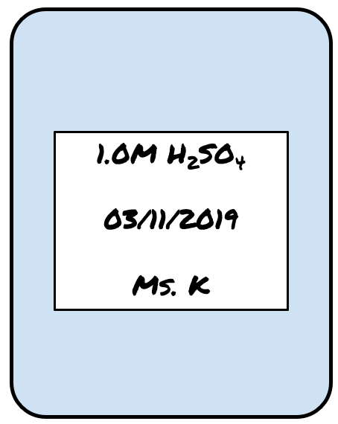
Explore - Labelling Solution Containers
Solutions should have the following information on their containers when stored:
➢Chemical name of solute
➢Concentration
➢Date prepared
➢Name of person who prepared the solution

Slide 20
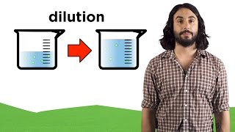
Explore - Dissolving
{Optional} For further help you can watch this video

Slide 21
Part 3: Apply

Slide 22

Apply- Complete the questions
Show all your work! Include formulas, conversions, units, etc.
For a lab, it requires 305mL of a 4M sugar solution. The labs then tells you to add 695mL of water to the solution. What is the final concentration of the sugar solution?
You want to create 375mL of a 0.450M solution of Sulfuric Acid. If you have a stock solution of 12M solution, how many mL of the stock is required?
280mL of water is added to 50mL of a 2M solution of Lead Chloride. What is the new concentration of the solution?

Slide 23
Next few slides provide answers to activities

Slide 24
Apply- Complete the questions
Show all your work! Include formulas, conversions, units, etc.
For a lab, it requires 305mL of a 4M sugar solution. The labs then tells you to add 695mL of water to the solution. What is the final concentration of the sugar solution? Ans: 1.22M
You want to create 375mL of a 0.450M solution of Sulfuric Acid. If you have a stock solution of 12M solution, how many mL of the stock is required? Ans: 14ml
280mL of water is added to 50mL of a 2M solution of Lead Chloride. What is the new concentration of the solution? Ans: 0.3M

Slide 25
Part 5: Beyond the course extensions
{optional}

